Slide 1
Bits and Bytes
LESSON 3

Slide 2
注意事项：
本讲对应教材第2章“信息的表示和处理”中的2.1节。其中2.1.1节~2.1.6节请大家自学完成。

Slide 3
Outline
Information Storage and Representation
Bits, Logic and Shift

Slide 4
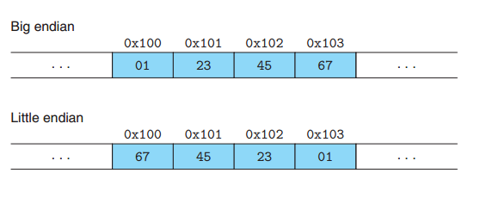
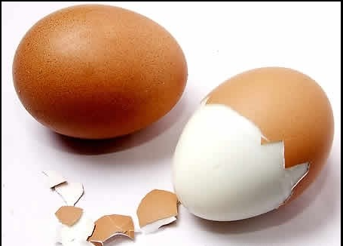
Addressing and Byte Ordering
Little endian: Intel
Big endian: IBM, Sun Microsystem（Oracle）
Example:0x1234567
Notes:
字节是存储数据的基本单位，也是寻址的基本单位
Little endian：low byte low address
Big endian：high byte low address

Slide 5
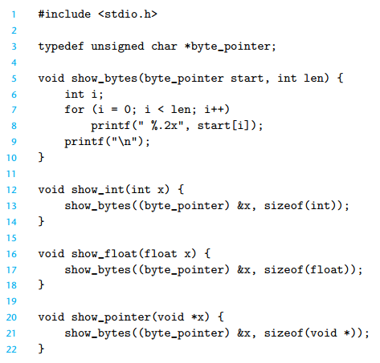
Explore Data Stored in Memory
Code to print the byte representation of program objects. This code uses casting to circumvent(规避，绕过) the type system.
Similar functions are easily defined for other data types.
Notes:
typedef 关键字
Printf 格式化输出
sizeof 运算符

Slide 6
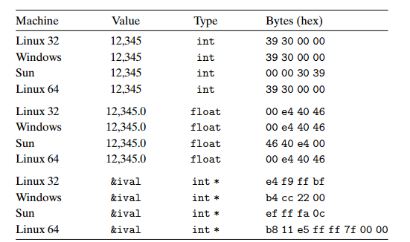
Result on Linux32/64; Win32; Sun
void test_show_bytes (int val)
{
int ival = val;
float fval = (float)ival;
int *pval = &ival;
show_int(ival);
show_float(fval);
show_pointer(pval);
}
Notes:
虽然表示内容相同，浮点型和整型内部的数据结构完全不同
在64位系统中，指针类型的长度为8字节

Slide 7
Machine Words
Any given computer has a “Word Size”
Nominal size of integer-valued data
and of addresses
Until recently, most machines used 32 bits (4 bytes) as word size
Limits addresses to 4GB (2³² bytes)
Increasingly, machines have 64-bit word size
Potentially, could have 18 EB (exabytes) of addressable memory
1EiB = 1024PiB
1PiB = 1024TiB
That’s 18.4 X 10¹⁸
Machines still support multiple data formats
Fractions or multiples of word size
Always integral number of bytes

Slide 8
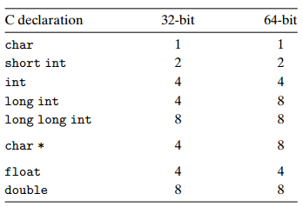
Example Data Representations
Notes:
Long型在不同平台表现不一致，不适合跨平台，可以使用long long型代替
也可以使用 sizeof 运算符解决跨平台的问题
45min

Slide 9
Representing Pointers
Sun
IA32
x86-64
EF
FF
FB
2C
AC
28
F5
FF
3C
1B
FE
82
FD
7F
00
00
int B = -15213;
int *P = &B;
Different compilers & machines assign different locations to objects
Even get different results each time run program

Slide 10
Representing Strings
Strings in C
Represented by array of characters
Each character encoded in ASCII format
Standard 7-bit encoding of character set
Character “0” has code 0x30
Digit i has code 0x30+i
String should be null-terminated
Final character = 0
Compatibility
Byte ordering not an issue
char S[6] = "18213";
IA32
Sun
31
38
32
31
33
00
31
38
32
31
33
00
Notes:
串尾符0 = ‘\0’

Slide 11
Representing Code
Different machine types use different and incompatible instructions and encodings.
Even identical processors running different operating systems have differences in their coding conventions and hence are not binary compatible.
Binary code is seldom portable across different combinations of machine and operating system.

Slide 12
Outline
Information Storage and Representation
Bits, Logic and Shift
Integer

Slide 13
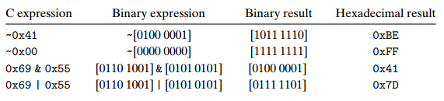
Bit-Level Operations in C
| for Or,
& for And,
~ for Not,
^ for eXclusive-Or.
Notes:
C语言中的位运算就是布尔运算中使用的那些符号
这些运算能运用到任何“整型”数据上

Slide 14
A Game for Bit-Level Operation
“void funny (int *x, int *y) {. . .}”能否只使用位运算完成两个数据的交换？
void funny(int *x, int *y) {
*x = *x ^ *y; /* #1 */
*y = *x ^ *y; /* #2 */
*x = *x ^ *y; /* #3 */
}
Notes:
程序有小问题？写的不够严谨

Slide 15
Mask（掩码）
假设x = 0x87654321，写出满足如下要求的C语言表达式
取x的最低有效字节，其它位置均为0。[0x00000021]
除了x的最低有效字节外，其它的位都取反，最低有效字节保持不变。[0x789ABC21]
x的最低有效字节设置为全1，其它字节保持不变。[0x876543FF]
答案：
A. x & 0xFF; B. x ^~ 0xFF; C. x | 0xFF

Slide 16
Logical Operations in C
C also provides logical operators
|| , && , !
“Short Circuit”
1.X && 5/X will never cause a division by zero,
2.p && *p++ will never cause the dereferencing of a null pointer. 3. 5 || X==Y
Notes:
位运算和逻辑运算两个区别

Slide 17
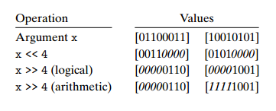
Shift Operations in C
Logical shift & arithmetic shift
The C standards do not precisely define which type of right shift should be used.
For unsigned data, right shifts must be logical.
For signed data (the default), either arithmetic or logical shifts may be used.
In practice, however, almost all compiler/machine combinations use arithmetic right shifts for signed data, and many programmers assume this to be the case.
Notes:
The C standards do not precisely define which type of right shift should be used. For unsigned data (i.e., integral objects declared with the qualifier unsigned), right shifts must be logical. For signed data (the default), either arithmetic or logical shifts may be used. This unfortunately means that any code assuming one form or the other will potentially encounter portability problems. In practice, however, almost all compiler/machine combinations use arithmetic right shifts for signed data, and many programmers assume this to be the case. Java, on the other hand, has a precise definition of how right shifts should be performed. The expression x >> k shifts x arithmetically by k positions, while x >>> k shifts it logically.

Slide 18
Undefined Behavior
Shifting by k, for large values of k ≥ w
w: for data type consisting of w bit
Implement by GCC
int lval = 0xFEDCBA98 << 32;
movl $0, -12(%ebp)
int aval = 0xFEDCBA98 >> 36;
movl $0, -8(%ebp)
unsigned uval = 0xFEDCBA98u >> 40;
movl $0, -4(%ebp)
Notes:
2.1.10 p37

Slide 19
Operator precedence issues
1<<2 + 3<<4 = ?
(1<<2) + (3<<4)
1<<(2 + 3)<<4
(1 << (2+3)) << 4
Notes:
拿不准的时候一定加括号

